Slide 1

CAPSTONE 2 FINAL REPORT

Slide 2

Problem Identification
This project seeks to help artists, music distributors and record label managers maximize financial benefits from their association with Spotify by building a model that will help predict songs using the structure of popular songs from 2000 -2023

Slide 3

Data Sources
Main dataset
Kaggle Spotify 1 million tracks
(1159796 rows and 11 columns)
Supplementary dataset
Annual GDP of the United States from 1929 to 2023
(5 rows and 96 columns)

Slide 4

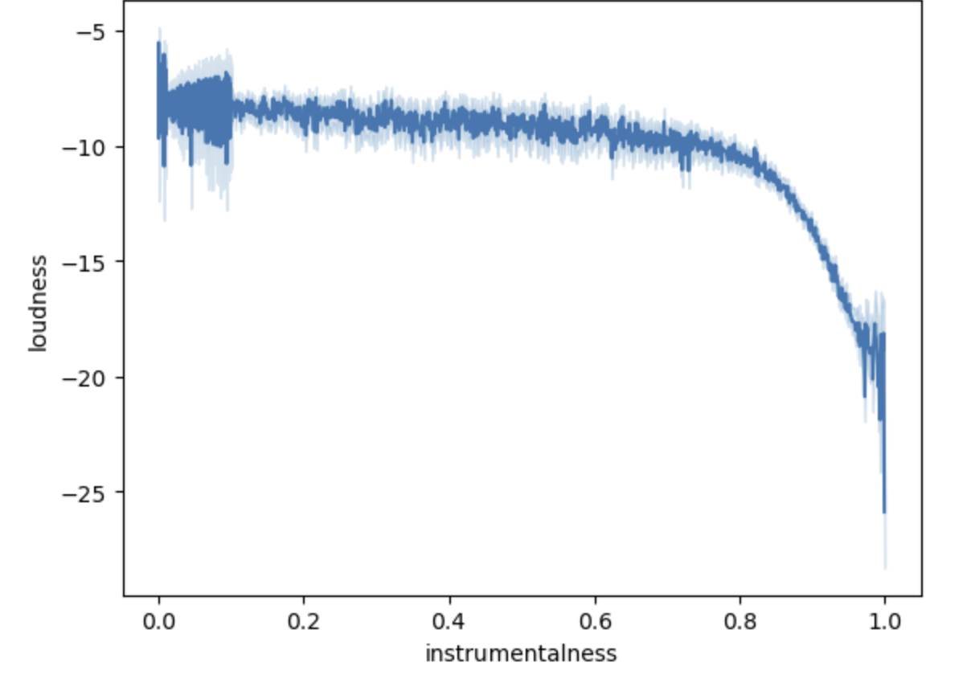
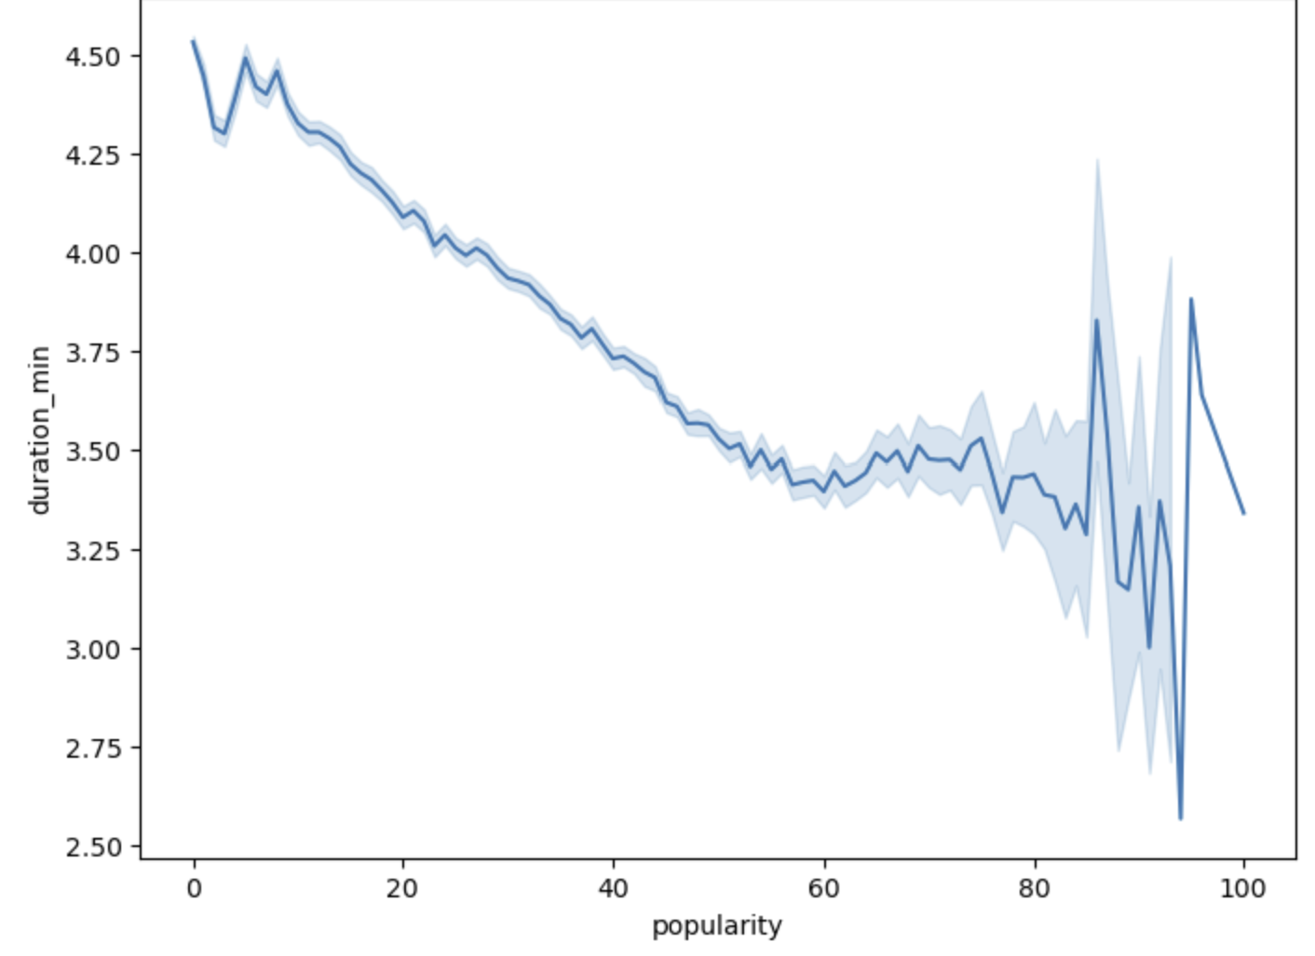
Findings
Instrumentalness does not mean loud song
Long songs are not popular songs

Slide 5
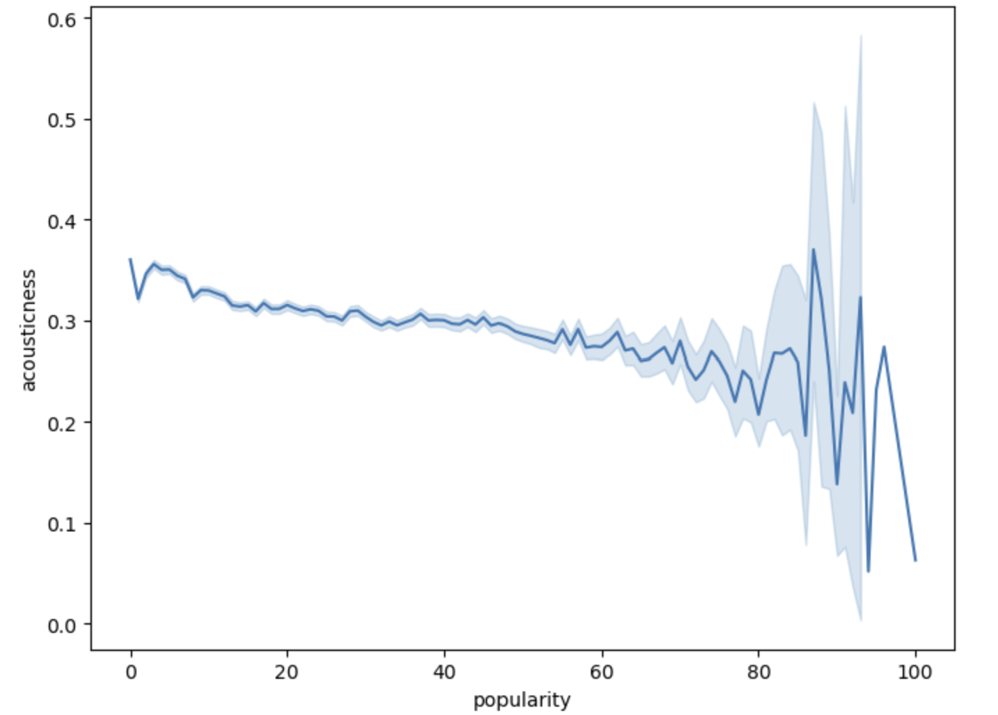
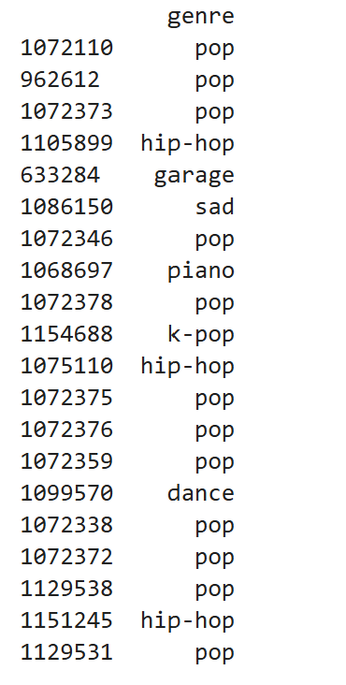
Findings
Popular songs have low acousticness
Most popular song genre is pop

Slide 6
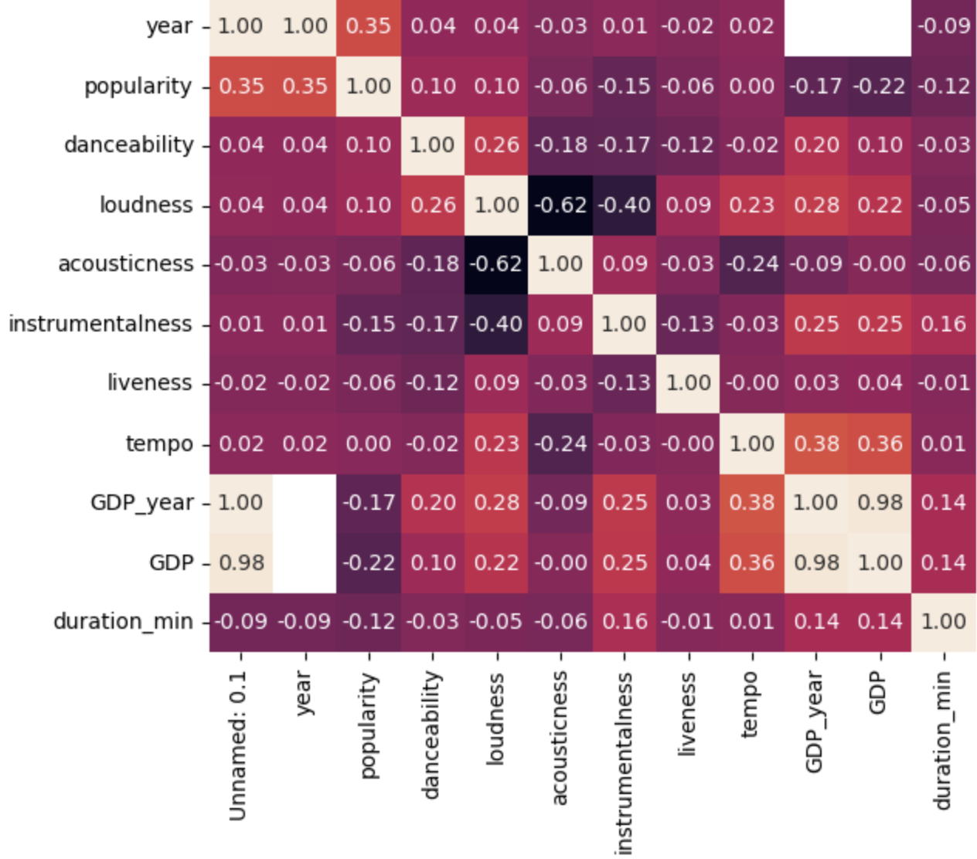
Heatmap findings
Popularity is:
not correlated to tempo
weakly correlated to danceability and loudness.
negatively corelated to acousticness, liveness,instrumentalness, duration_min, GDP_year, GDP
strongly correlated to year

Slide 7

Multicollinearity detection
Strong correlation between independent variables:
Loudness and instrumentalness
loudness and acousticness
GDP_year and GDP

Slide 8

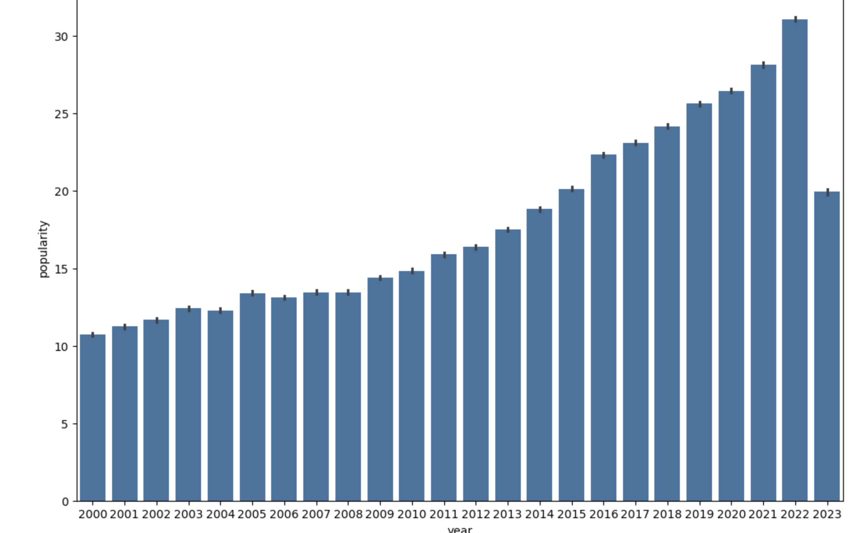
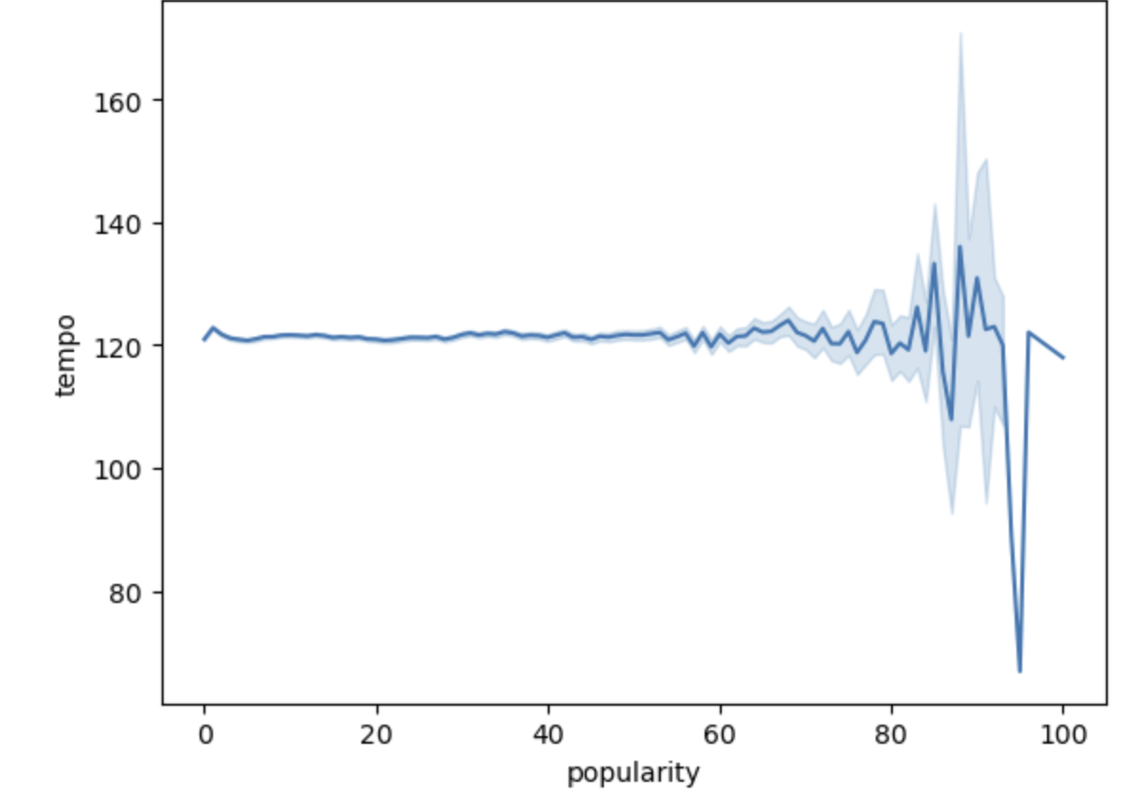
Recommendations
The popularity of songs is influenced by the year song was posted on Spotify. Spotify songs have gained more popularity in recent years than they did in previous years.
Tempo does not influence song popularity

Slide 9
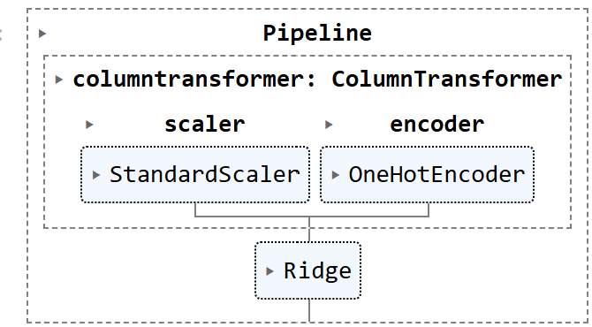
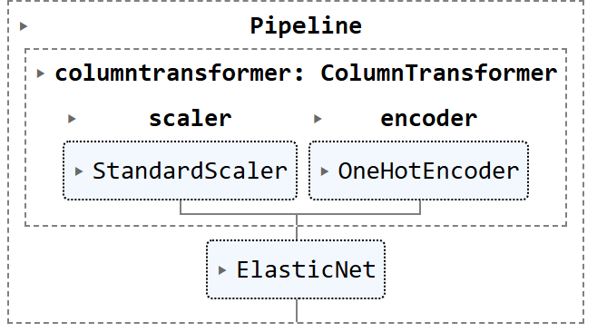
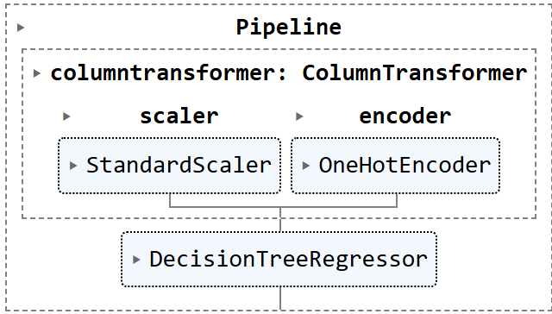
Models
Ridge Regression
ElasticNet
DecisionTreeRegressor

Slide 10
Model Assessment
After using cross validation to fit each model
Performance Metric | Ridge Regression | ElasticNet | Decision Tree Regressor
R-squared | 0.546 | 0.128 | 0.151
Mean Absolute Error | 8.207 | 12.104 | 11.794
Mean Squared Error | 10.698 | 14.811 | 14.606
Best model is Ridge Regression

Slide 11
Observations Further work
Dropping categorical feature (genre) from the feature list used to build the model makes the model perform poorer.
Buildng models with all the features in the dataset improves model performance
Further work on this project must focus on improving the current model by increasing the data.

